Slide 1
0-Days &
Nat 20s
CVSSv3
Through the lens of Dungeons & Dragons

Slide 2


Alex Hoffman @RedWedgeX
Pentester/Red Teamer @
Ham Radio Enthusiast (N3RDO)
D&D Player & Dungeon Master
CactusCon Staff & VetCon Discord Admin
All Around Great Guy
Obligatory “Presentation and opinions are my own and have not been approved or vetted by my employer.”

Slide 3
Common Vulnerability Scoring System
Free and open industry standard for assessing the severity of computer system security vulnerabilities.
Measures SEVERITY of a vulnerability while considering RISK.
Originally released in 2005. Current version, 3.1, released June 2019.
Can be used by security professionals as a tool to allow responders to prioritize responses and resources according to threat and system owners to understand the risks to their products.
Notes:
Uses-
Pentester – provide accurate, measurable findings to my customers
Defender – Understand risk as it applies to your environment an d triage importance
Sys/Netadmin – Prioritize patching and/or understand ways to reduce risk using temporal & environmental scoring
Mention the calculator

Slide 4
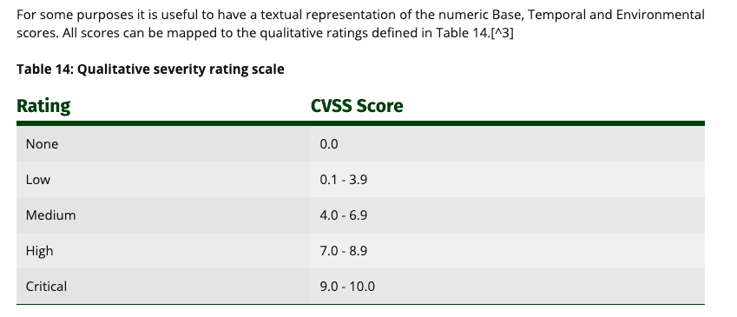
CVSS Qualitative Severity Ratings

Slide 5
CVSS Vector String
A text representation of a set of CVSS metrics.
Commonly used to record or transfer CVSS metric information in a concise form.
Think of it like your D&D stats block!
D&D:5E/STR:16/DEX:14/CON:18/INT:8/WIS:13/CHR:10

Slide 6

Our Character
Name: Confluentus
Race: Dwarf
Class: Bard
Background: Historian and capable fighter who travels the realm adventuring and thirsting for knowledge, combat, and a good cup of Java.

Slide 7
The Story So Far
THE TOMB OF ZEROHDEH
Notes:
Our hero Confluentus has wandered the land of Internetia for 15 years. He has traversed the sub-oceanic lightways, the series of elven tubes, and adventured beyond the stars and back. He has collected vast libraries of knowledge, and the monks of the DeVops Monastery in the land of Jira have taken him in as their foretold champion. But today, he faces his greatest threat yet. He has ventured far from home to a place feared by professionals. Today, he encounters...

Slide 8
The Story Continues
Notes:
Confluentus triumphantly storms from room to room, destroying all that stand in his way. He stands tall, uninjured and undamaged. He feels it, he knows he must be close. The prize will be his – THE CLOAK OF INVULNERABILITY must be through this last door. He bursts in and find himself face to face with our villain...

Slide 9
The BBEG (Big Bad Evil Guy)
Name: Crypt0K1d666
Race: Human
Class: Hackromancer
Background: ???
Notes:
Could be a chaotic neutral kid just trying to see what he can see. Could be lawful evil state actor or corporate entity with nefarious intentions trying to bring glory to her homeland or raise stock prices. Who knows?

Slide 10
The Battle
Notes:
Crypt0K1d666 quickly thumbs through the spell book, a wry smile creeping across thin lips. In a long-dead language the words flow, casting the ancient spell of CVE-2019-3396:
“Confluence Server before 6.6.12, I achieve path traversal via a server-side template injection weakness in your WIDGET CONNECTOR component!”
Confluentus feels week and falls to his knees.
Crypt0K1d666 rolls for damage…

Slide 11
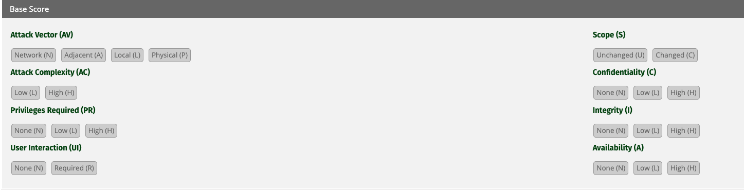
The Attack Roll

Slide 12
Base Metrics - Exploitability
AV – Attack Vector
context by which vulnerability exploitation is possible.
N (Network), A (Adjacent), L (Local), P (Physical)
AC – Attack Complexity
The conditions beyond the attacker’s control that must exist in order to exploit the vulnerability.
L (Low), H (High)
PR – Privileges Required
The level of privileges an attacker must possess before successfully exploiting the vulnerability.
N (None), L (Low), H (High)
Notes:
AC: MITM is considered complex (so, high). Another example is in case where a specific component must be enabled or configured a certain way to make the attack possible. Since enabling that component is beyond the attackers control, it’s a high AC.

Slide 13
Base Metrics - Exploitability
U – User Interaction
“the requirement for a human user, other than the attacker, to participate in the successful compromise of the vulnerable component”
N (None), R (Required)
S – Scope
whether a vulnerability in one vulnerable component impacts resources in components beyond its security scope.
All the subjects and objects under the jurisdiction of a single security authority are considered to be under one security scope.
U (Unchanged), C (Changed)
Notes:
Better define scope with examples

Slide 14
Impact Metrics - Impact
C – Confidentiality
“the impact to the confidentiality of the information resources managed by a software component due to a successfully exploited vulnerability”
H (High), L (Low), N (None)
I – Integrity
“impact to integrity of a successfully exploited vulnerability. Integrity refers to the trustworthiness and veracity of information.”
H (High), L (Low), N (None)
A – Availability
“The impact to the availability of the impacted component resulting from a successfully exploited vulnerability.”
H (High), L (Low), N (None)

Slide 15
The Attack Roll
9.8
(Critical)
Vector String - CVSS:3.0/AV:N/AC:L/PR:N/UI:N/S:U/C:H/I:H/A:H
Notes:
Is it scope change?

Slide 16
The Battle Continues
Notes:
Confluentus feels the exploit land it’s crushing blow, penetrating his outer armor and executing itself deep into his host operating system. He calls out to his maker, praying for help.
”Oh great and beautiful Atlassia, bless me and heal me, protect me from this evil, Chat with my hip, turn the gaze of your Fisheye upon your faithful servant. Intervene on my behalf and Stride down to my side, oh great and all powerful collaborator!”
~~~CLICK~~~
Suddenly, a light shines down from above. Confluentus feels the healing word of Official Fix, as his creator, Atlassia, blesses him. ”It’s coming” he hears in a whisper. “Hold strong child, for the patch will be applied after testing"

Slide 17
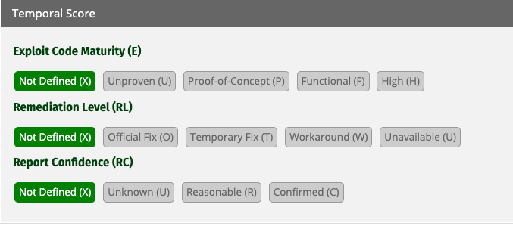
Devine Intervention
Notes:
Temporal scores, as the name suggests, are specific factors related to the vulnerability at a point in time.
Base scores never change
Temporal change based on situations at a given time (now)

Slide 18
Temporal Metrics
E – Exploit Code Maturity
“the likelihood of the vulnerability being attacked and is typically based on the current state of exploit techniques, exploit code availability, or active, “in-the-wild” exploitation.”
H (High), F (Functional), P (Proof-of-Concept), U (Unproven)
RL – Remediation Level
The availability of options for remediating the vulnerability
U (Unavailable), W (Workaround), T (Temporary Fix), O (Official Fix)
RC – Report Confidence
”the degree of confidence in the existence of the vulnerability and the credibility of the known technical details.”
C (Confirmed), R (Reasonable), U (Unknown)

Slide 19
Devine Intervention
9.4
(Critical)
Vector String - CVSS:3.1/AV:N/AC:L/PR:N/UI:N/S:U/C:H/I:H/A:H/RL:O

Slide 20
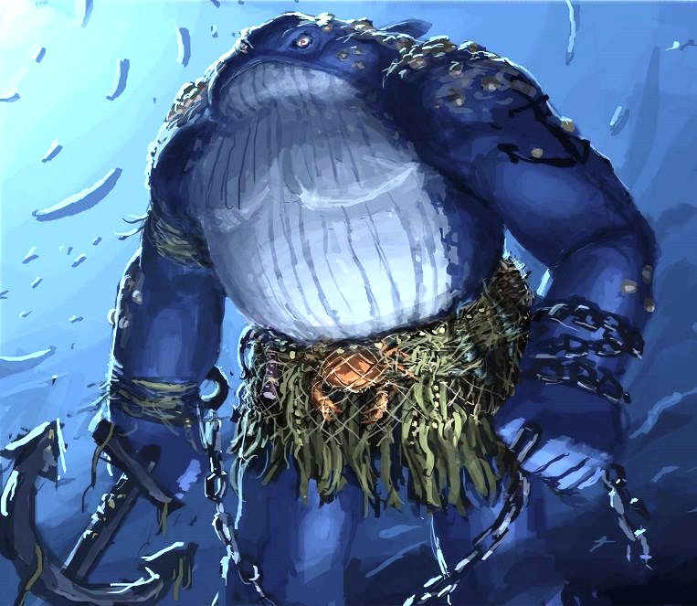
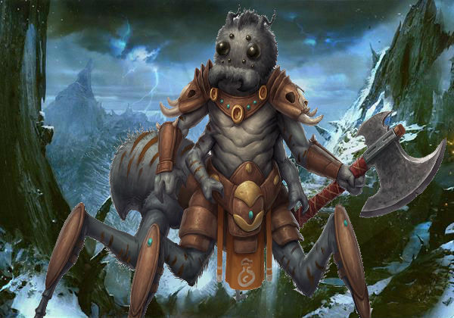
But There is Hope…
Name: Cisco Flamehand
Race: Human
Class: Network Firewall
Name: Docker
Race: Dire Whale
Class: Containerization Engine
Name: Arachne Bluecoat
Race: Giant Spider
Class: Web Filtering Proxy
Notes:
But all is still not well. Confluentus is damaged and broken. Weak and on his knees, barely able to stand. The blessing from his maker helped a bit, but he is still in CRITICAL condition. He is not long for this world. He feels the immanent shutdown of his functions, and the denial of his service. But then, just as his eyes close, he sees his friends approach in the distance…
”HOLD THE LINE”, Cisco Flamehand screams, as she casts FIREWALL, segregating Confluentus from the internet. “WE JUST NEED TO HOLD OUT UNTIL THE PATCH ARMY ARRIVES!” Docker bellows, enveloping Conlfuentus in a container, making host exploitation more complex. Arachne Bluecoat chitters in spiderspeak, weaving a proxy web between the party and the enemy, protecting them from accidently accessing any malicious locations in the battlefield.

Slide 21
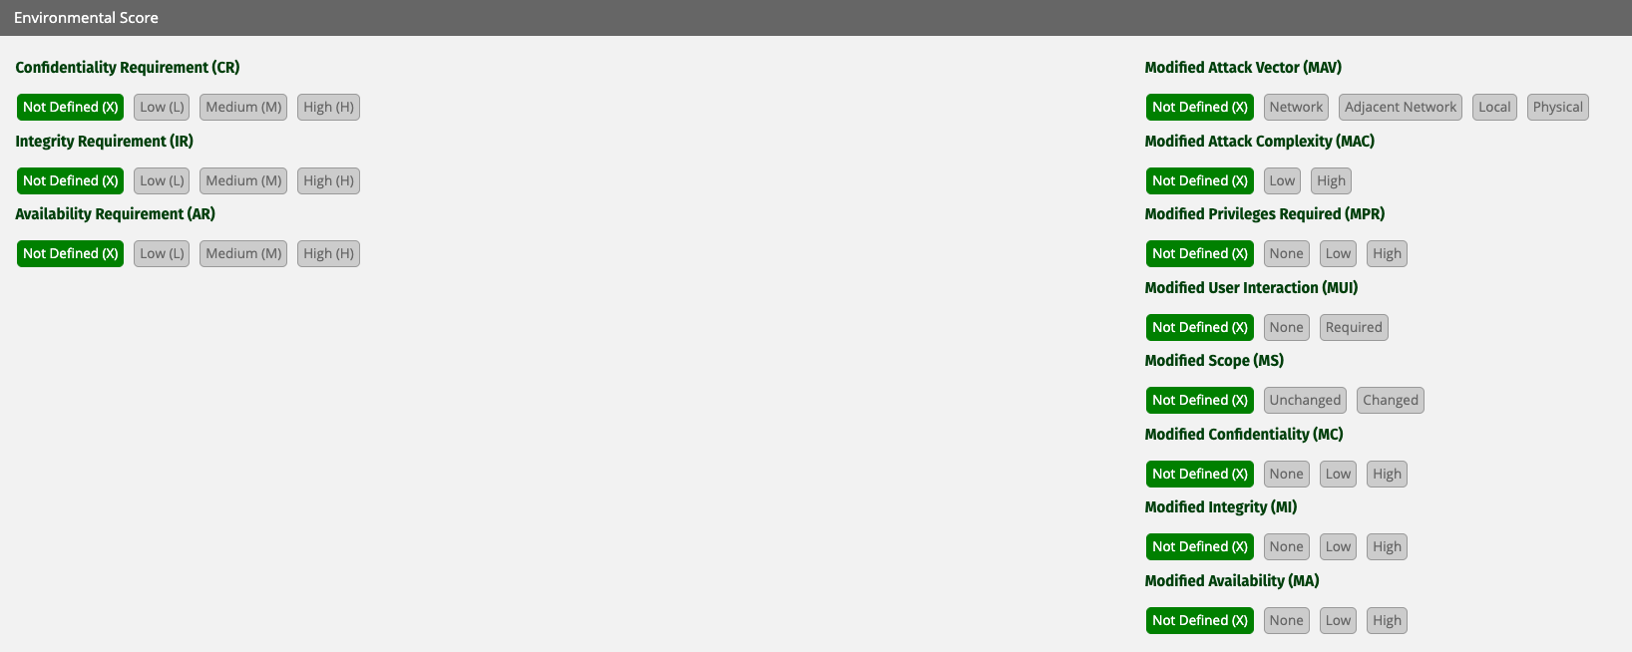
The Party Defends…
Notes:
Base scores never change
Temporal change based on situations at a given time (now)
Environmental changes based on the specific use case, environment, and implementations of the product

Slide 22
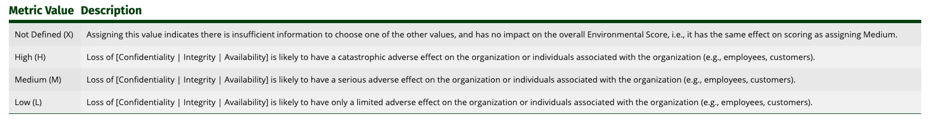
Environmental Metrics– Security Requirements
These metrics enable the analyst to customize the CVSS score depending on the importance of the affected IT asset to a user’s organization.

Slide 23
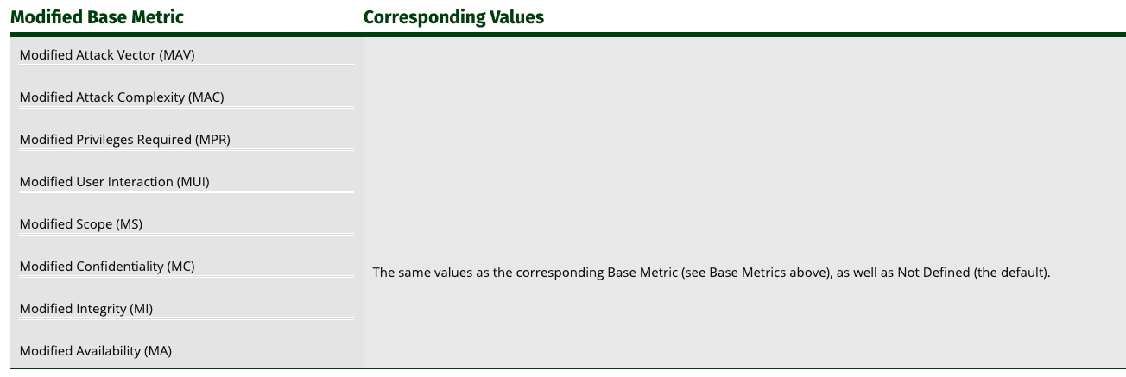
Environmental Metrics– Modified Base Metrics
These metrics enable the analyst to override individual Base metrics based on specific characteristics of a user’s environment.

Slide 24
The Party Defends…
6.9
(Medium)
Vector String - CVSS:3.1/AV:N/AC:L/PR:N/UI:N/S:U/C:H/I:H/A:H/RL:O/CR:L/MAV:A/MAC:H

Slide 25
The Army Arrives…
Crypt0K1d666 has been defeated…
FOR NOW.
Notes:
The Army has arrived, and they’ve brought with them THE PATCH. This holy object, when applied to Confluentus, protects him from the evil of CVE-2019-3396. They make quick work of Crypt0K1d666, who falls to the ground, defeated…

Slide 26
Takeaways
CVSS isn’t just overall scores and pretty QSRs!
Understanding the whole vector string (not just the number or word rating) helps get a better understanding of the vulnerability.
IT professionals can use the Environmental Scores calculators to figure out ways to protect vulnerable systems in the interim while preparing long-term solutions!
https://www.first.org/cvss/calculator/3.1

Slide 27

Thank you!
Twitter: RedWedgeX
Discord: RedWedgeX
Github: RedWedgeX
Email: RedWedgeX(at)Protonmail.com
(Sensing a theme?)
Questions?
Notes:
(Remember to thank Digital Overdose con)

